Slide 1
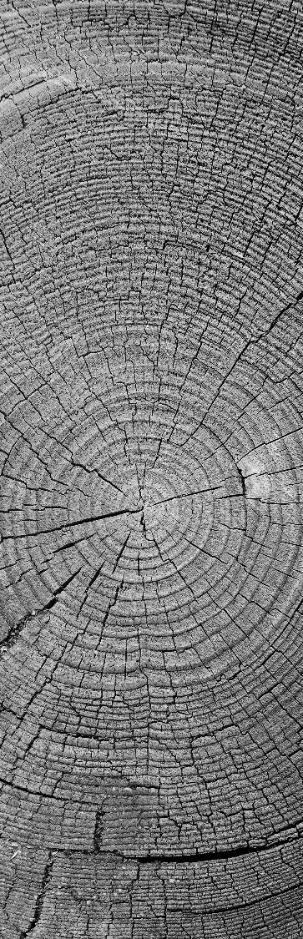

The Bot Squad
Week 1
Northumbria
University
Introduction to the Society

Slide 2
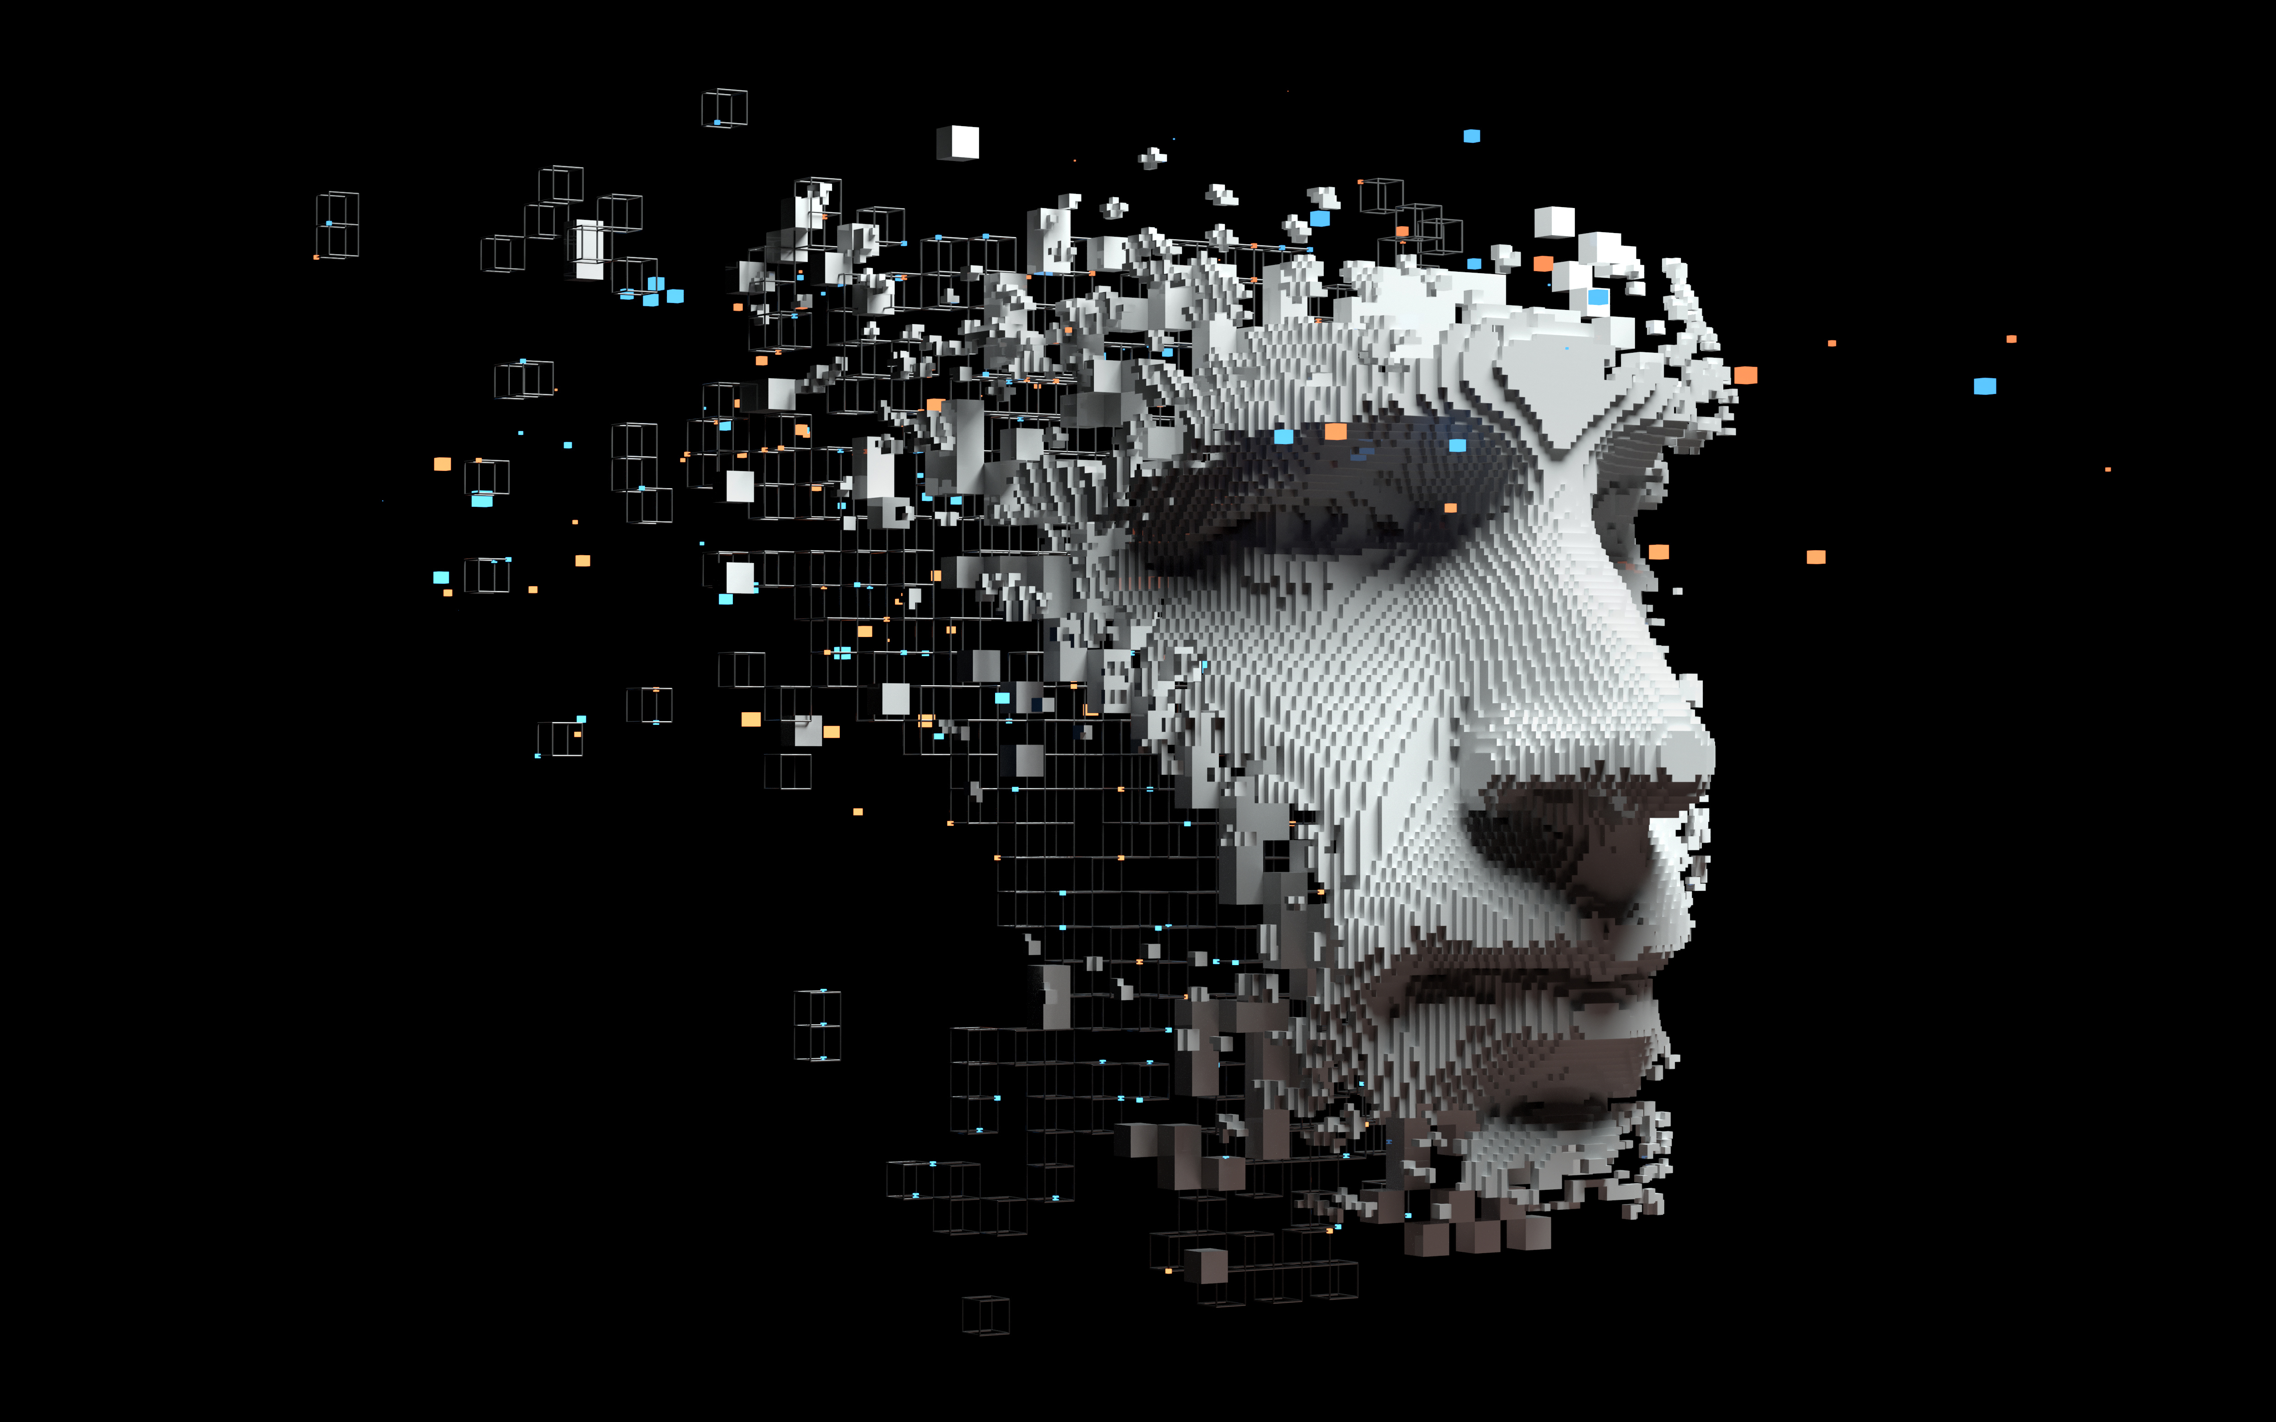
Part 1
What we will be doing as a society

Slide 3
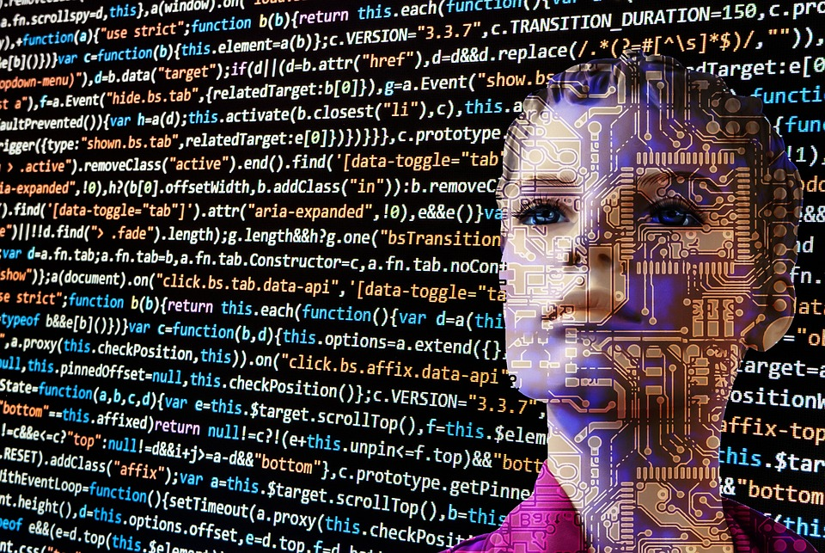
What?
Northumbria
University
What we Are Doing
As a society we will learn to build an autonomous AI Agent whether it is a chat bot, predictive model or anything else.
We will be doing this with the aim of having a fully operational Beta to present at the end of the society.

Slide 4

Why?
Northumbria
University
Why we Are Doing what we are doing
We are creating an AI model to gain hands on experience in developing a real product which by the end of the academic year we can present to the university's careers team and perhaps some other local businesses.

Slide 5
When?
Northumbria
University
When we Are Doing what we are doing
Week 1-2
Week 3-5
Week 6-8
Week 9-12
Week 13-17
Week 18
Introductory/Getting to know Each other
Case Studies and types of AI Models you can create
Brainstorming and choosing Idea
Start Working On Idea. Should have some sort of Backend Functionality
Completing Idea
Pitching to careers / local companies
After Each Checkpoint There will be a social commencing straight after the society has concluded that day

Slide 6
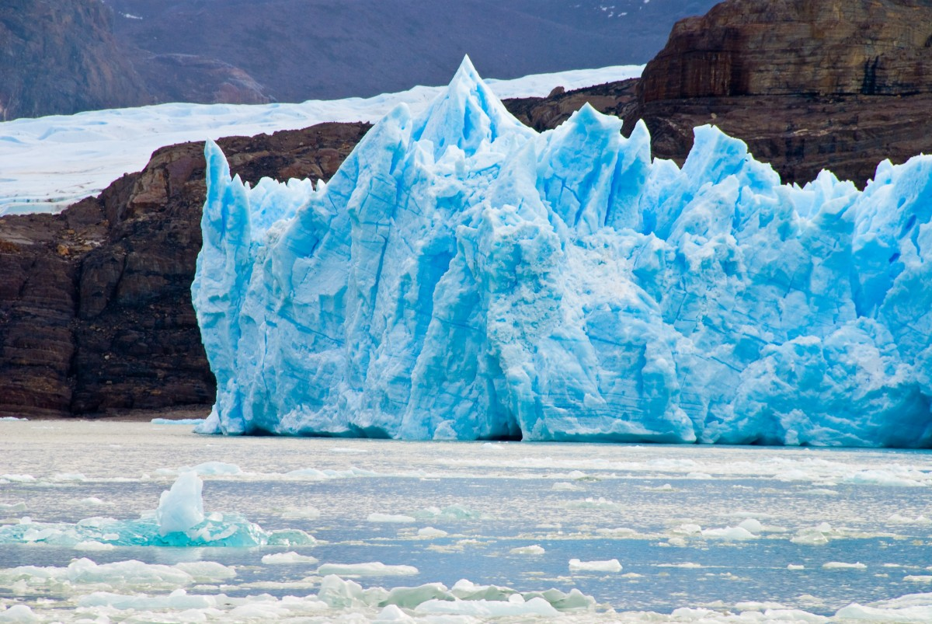
Part 2
Part 2
Ice Breaker
Icebreaker

Slide 7

Favourite AI Character
Northumbria
University
What are your favourite AI characters and why?
If you don’t have one, create your most ideal AI weather it be used for practical use or not
Examples could consist of physical AI or Non-Physical
Physical could be an autonomous clothes folder
Non-Physical could be something like Jarvis from iron Man

Slide 8
GET IN GROUPS OF 2
Northumbria
University
Discuss with a partner for 10 minutes on what you believe an AI is and how people create AI
After the 10 minutes is up there will be a small presentation per team.
Some of you may be thinking what's the point in this. Well, the point is to see how your knowledge on artificial intelligence changes along the course of this society.

Slide 9
What is AI
Artificial Intelligence is about building machines and software that can use data to produce outcomes based on certain accuracies. In doing so these applications or machines can come across as INTELLIGENT.
SO What is Intelligence????

Slide 10
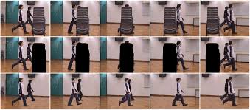
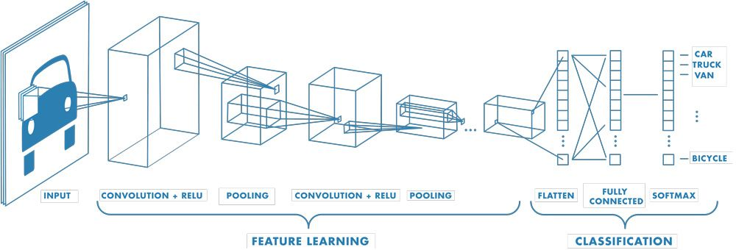
The Ability to recognise patterns
The ability to recognise patterns in images and videos.

Slide 11
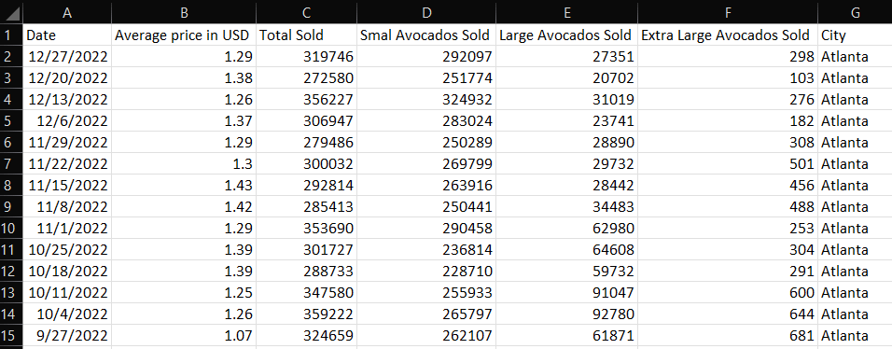
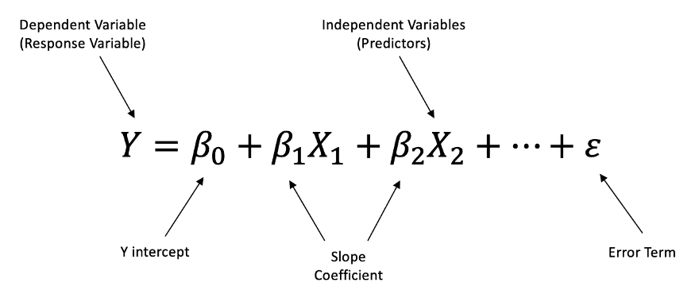
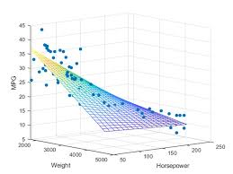
Image SLide
Ability to make decisions
HOW MANY AVACADOS TO STOCK PER DAY

Slide 12
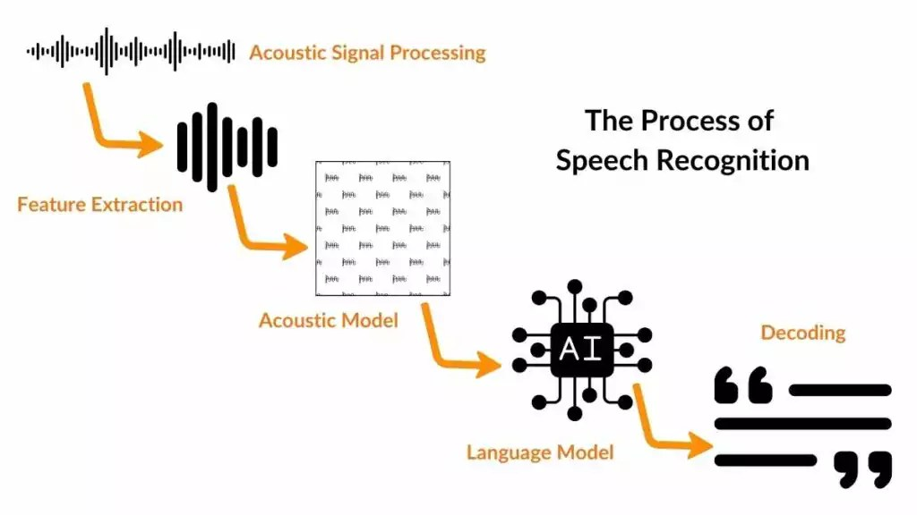
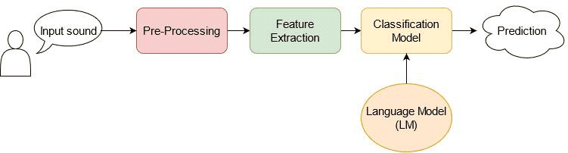
Ability to Understand Language
Can anyone tell me an AI that uses speech recognition??
Segregates words into their own word level labels
With the help of a pretrained language model a classifier will say what word each label is
Remove background noise

Slide 13
GEN AI
Gen AI is trained on a very, very, large data set
of either videos, photos or sounds depending on the AI being created
By doing this the model starts to recognise patterns on how shapes form faces, on
how words fit together, and how notes build melodies.
From this data, gen ai can then for example, create images of cats wearing hats, or dogs wearing shoes. lol

Slide 14

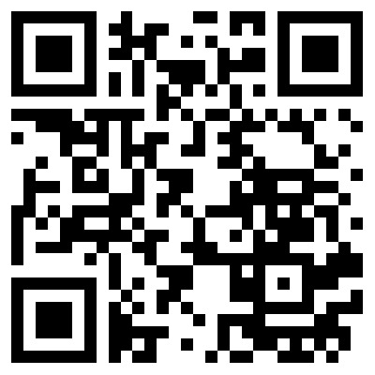
INTERACIVE GAME TIME

